Slide 1

Improving Percentage of Observation Status Discharges within 48 hours

Slide 2
Background: Shift in Observation Discharges associate with 2 midnight rule

Slide 3
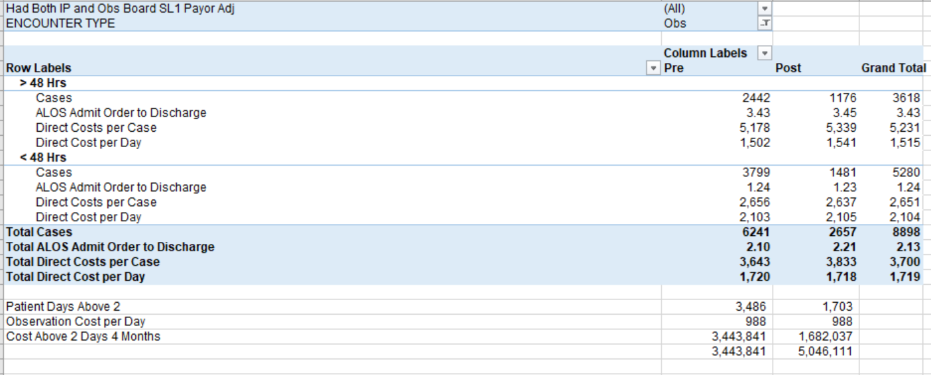
Financial Impact
Increasing the percentage of patients classified brings us in line with national average, which also increased with the introduction of the 2 midnight rule, and required that we treat discharge observation patients more in line with national averages too.

Slide 4
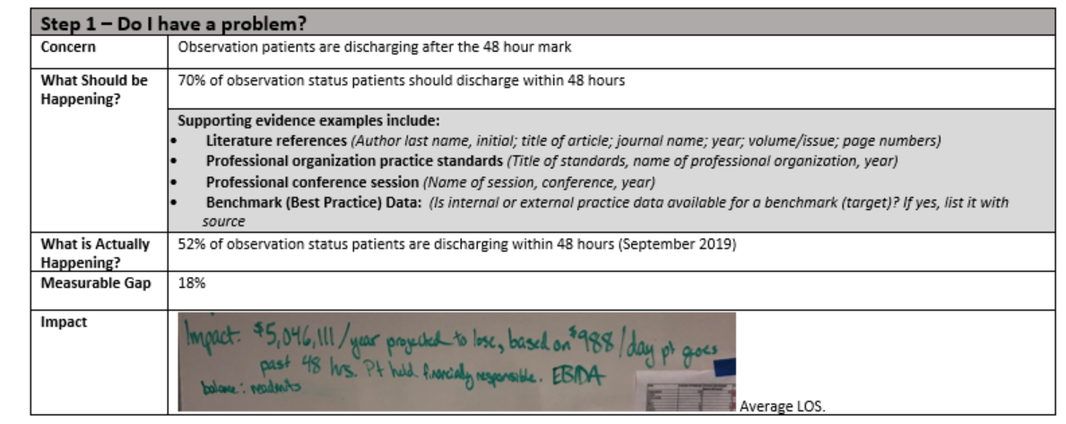
Step 1
 | ALOS | ALOS
 | Hours | Days
KP | 52 | 2.17
Salem Clinic | 60 | 2.50
SHMG | 65 | 2.71
All providers | 55 | 2.29

Slide 5
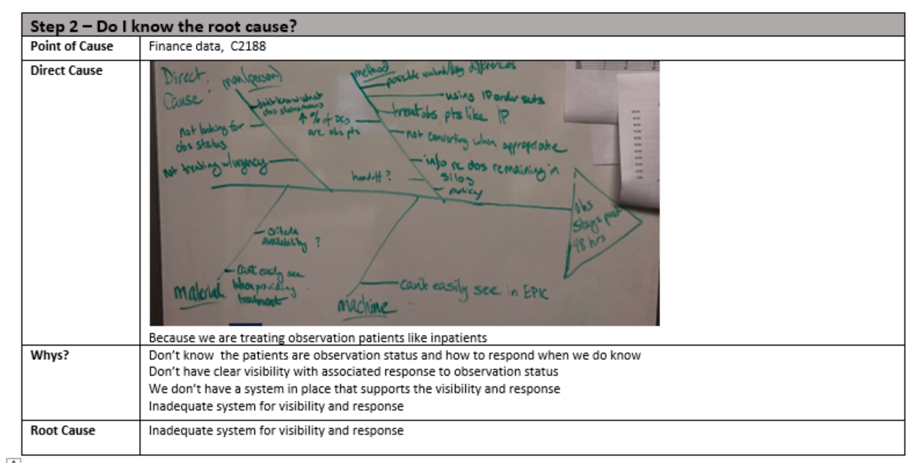
Step 2

Slide 6
Containment

Slide 7
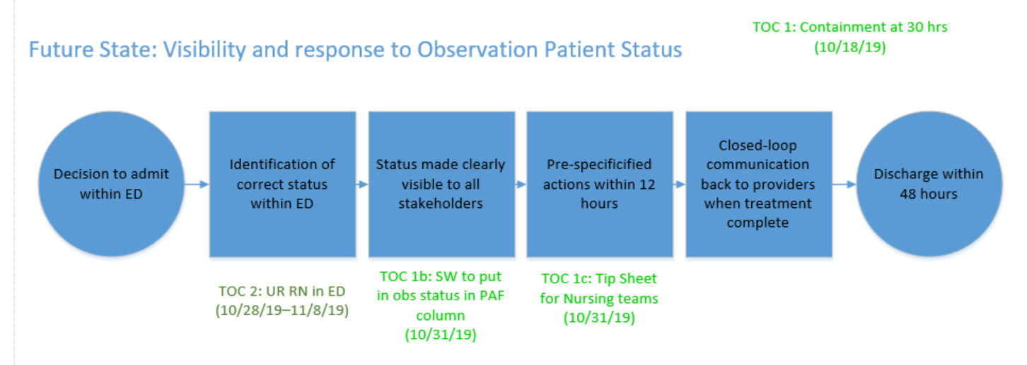
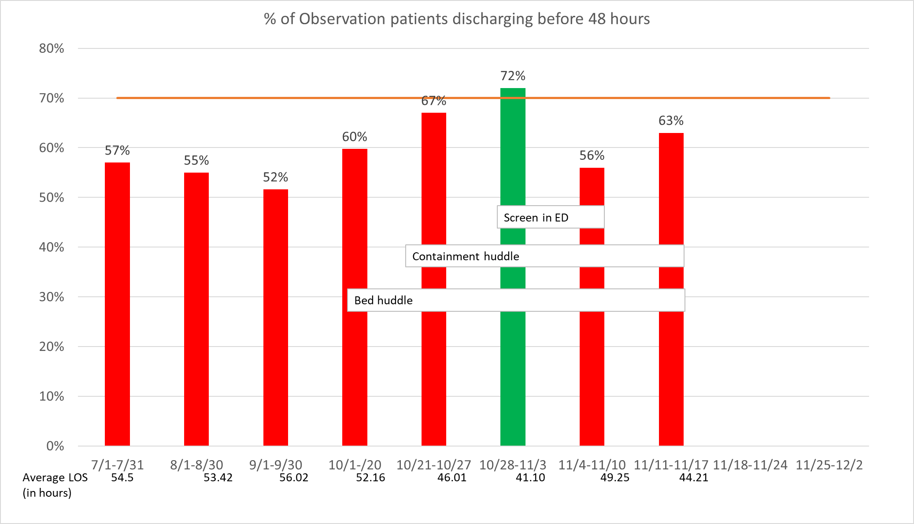

Slide 8
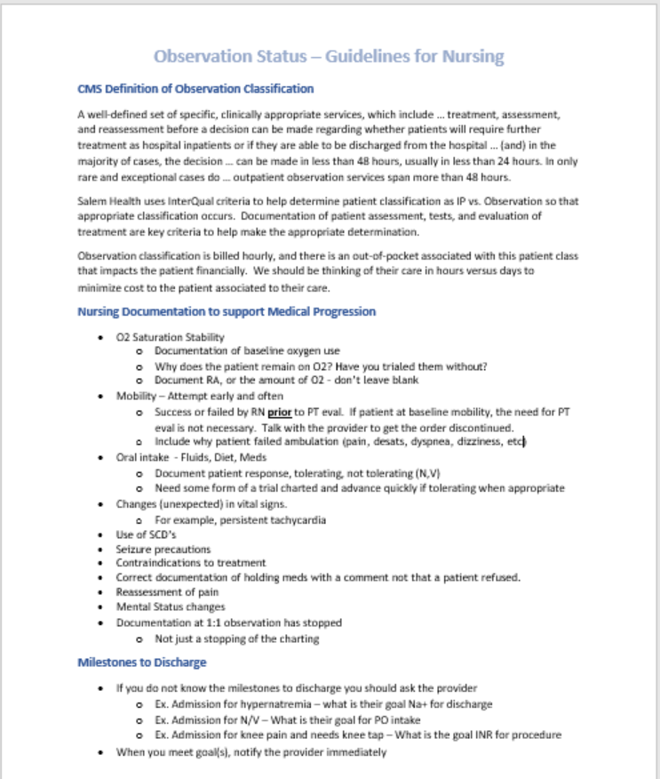

Slide 9
Projected Savings

Slide 10

Rapid Improvement Event

Slide 11
System Design
Goal: By end of RIE (11/19/19) we will have created a system ready for testing
Attributes of our system:
  Compliant with regulatory
  Delivers care in least costly manner
  In line with triple aim (cost, outcome, experience)

Slide 12
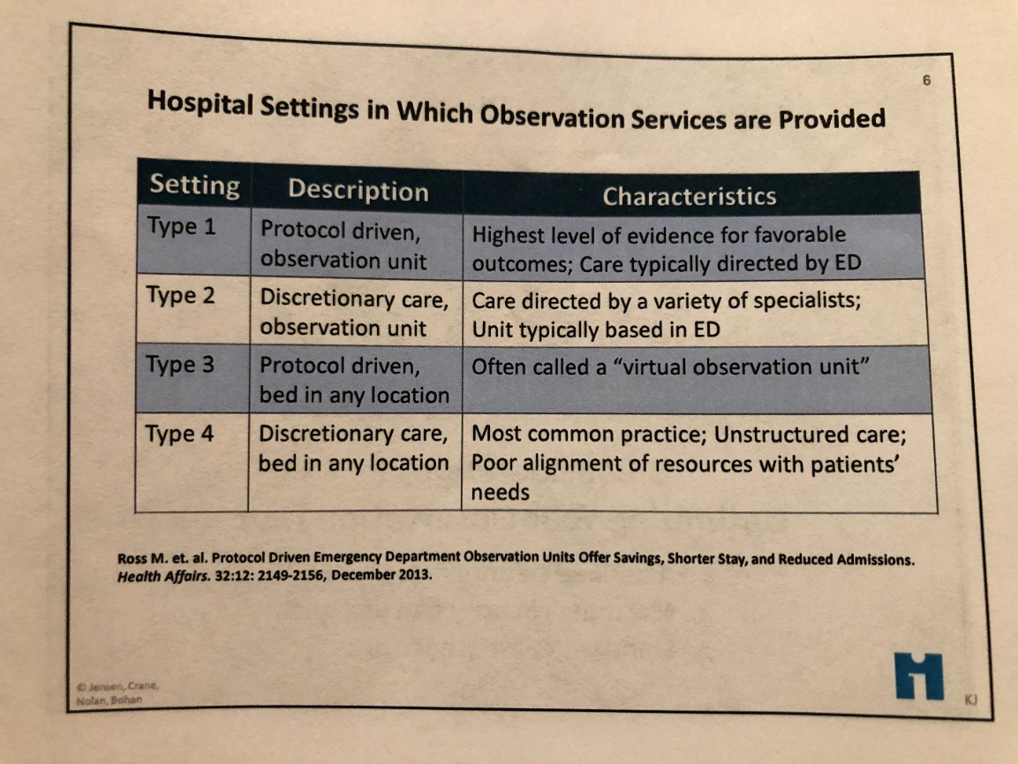
Models of Care
Currently we are in Type 4. To best align with the defined attributes, we want to move toward type 2 to type 1.

Slide 13
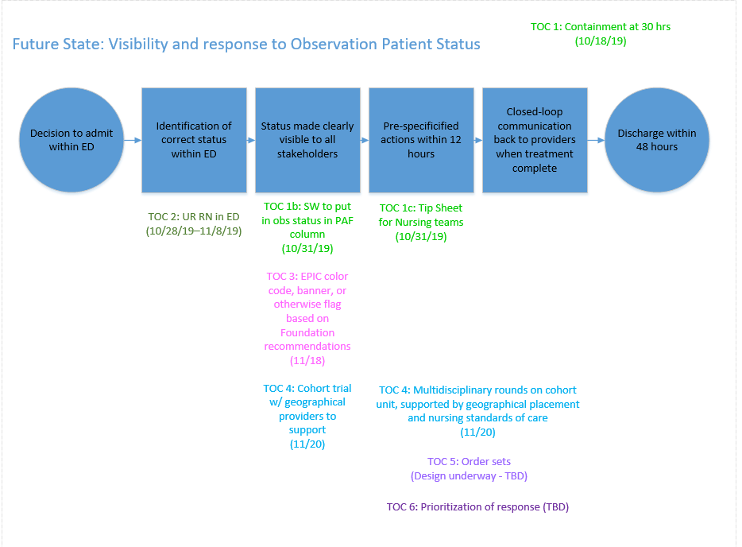

Slide 14
What type of unit?
Needs to accommodate many different diagnoses, and be tele-capable.

Slide 15
TCU to CDU Plan
Where: TCU. Tele-capable, 14 beds available
When: Start cohorting TOC 11/20/19, accomplished via attrition starting 11.18.
How:
Staffing:
  2 providers that rotate in, with NP to support
  4 RNs or 3RNs and 1 CNA (use HPPD)
  1 Care Manager
Supported by Multidisciplinary rounding:
  7:45 am and 2:00 pm. Consider adding evening in later TOC.
  1 minute per patient, or less. Ask/answer 2 questions:
    What is still keeping the patient here?
    What action is needed? (Action can include converting to IP)
  Rounding made up of: provider, bedside RN, Care Manager. UR RN to join 1 time per day. Charge RN to support.

Slide 16
Who: Patient Criteria
Admission Criteria:
Meets CMS Observation Criteria
Point of entry to Salem Health is the Emergency Department
Observation class patients under the care of the Salem Health Medical Group (SMHG)
Stable vital signs (definition of stability is patient specific and is a discussion with the hospitalist)
Length of stay expected to be 6 – 48 hours
Exclusion Criteria:
Patient meets inpatient criteria
Active psychiatric conditions or 1:1 behavioral/restraints
Patients experiencing ETOH withdrawal
Patients where it is a reasonable assumption that they may need a Skilled Nursing Facility post discharge or have complex discharge needs
Home or Trilogy ventilators
Patients requiring nursing care for all activities of daily living
Patients who are actively dying

Slide 17
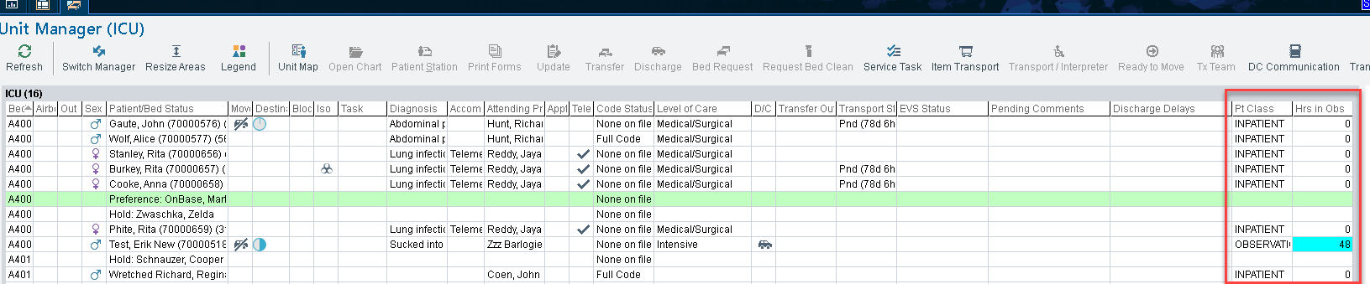
EPIC Functionality to support visibility

Slide 18
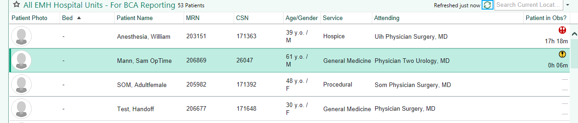
Patient List & System List
Colors: Yellow 0-23 hours, Orange 24-35 hours, Red 36 hours and above

Slide 19
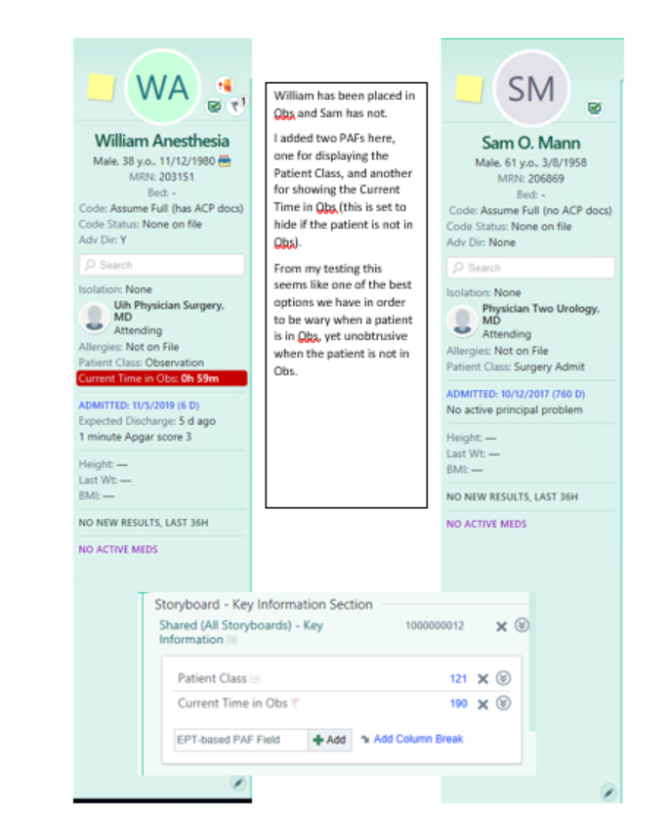
Storyboard

Slide 20
Order Set
Modify admission order set to create an observation specific set
  Labs default to stat, add cardiac enzymes
  Diagnostic tests default to urgent
  Add medical consults
  Remove PT/OT and IP Rehab from order set
Department override on this unit to stat

Slide 21
Interim Plan – Ancillary Teams
Lab: Able to view in medicopia, and will add column to patient lists, and prioritize : 1) stat, 2) observation, 3) routine
Imaging:
  XR and CT will monitor class and prioritize.
  Nuc Med, MRI and US visibility to view broken. Following up with IS.
Acute Rehab: Will monitor for orders and treat same as ED
CVNIS: Will be able to see in charts an prioritize.
Neurodiagnostics: Will use patient lists to see status and prioritize. Tech will come in at 7:30, check list and see observation patients

Slide 22
Other support documents
Nursing standards of care
Admission criteria
FAQ
Scripting to patients
Staffing plan
Barriers tracker

Slide 23
Metrics
Process
Average daily census on CDU (CDU)
% Adherence to 2x/day multidisciplinary rounds (CDU, hospitalists, Care Management)
Observation order set utilization rate (hospitalists)
% follow service level agreement(Ancillary units)
Outcome
% of patients discharging within 48 hours
Average LOS
Balance
Re-admits
# wrong classifications on admit (UR RN)

Slide 24

Questions

